Slide 1




Analyzing and Forecasting Construction Costs in Calgary
Presented by: Sudeshna Mondal
M2M Tech DataTalent Program – Cohort 17
📅 August 2025
PowerBI Link
Streamlit Link
GitHub Repo

Slide 2

Agenda
Project Overview
Data Preparation & Cleaning
Exploratory Analysis
Outlier Detection & Transformation
Modeling Approaches (XGBoost, Stratified)
Results & Insights
Power BI Dashboard & Streamlit App
Conclusion & Next Steps

Slide 3
Project Objectives
The core objectives for this project were clear and focused, aiming to provide actionable insights for city planners.
1
2
3
Predict ProjectCost
Support City Planning
Identify Key Drivers
This project analyzes 20+ years of Calgary building permit data to uncover community trends and builds a predictive model to estimate project costs based on permit attributes.
Enhance budgeting, resource allocation, and long-term cost forecasting for urban development by leveraging a Power BI dashboard and an interactive Streamlit web app.
Pinpoint the most influential factors impacting construction costs within the city.

Slide 4
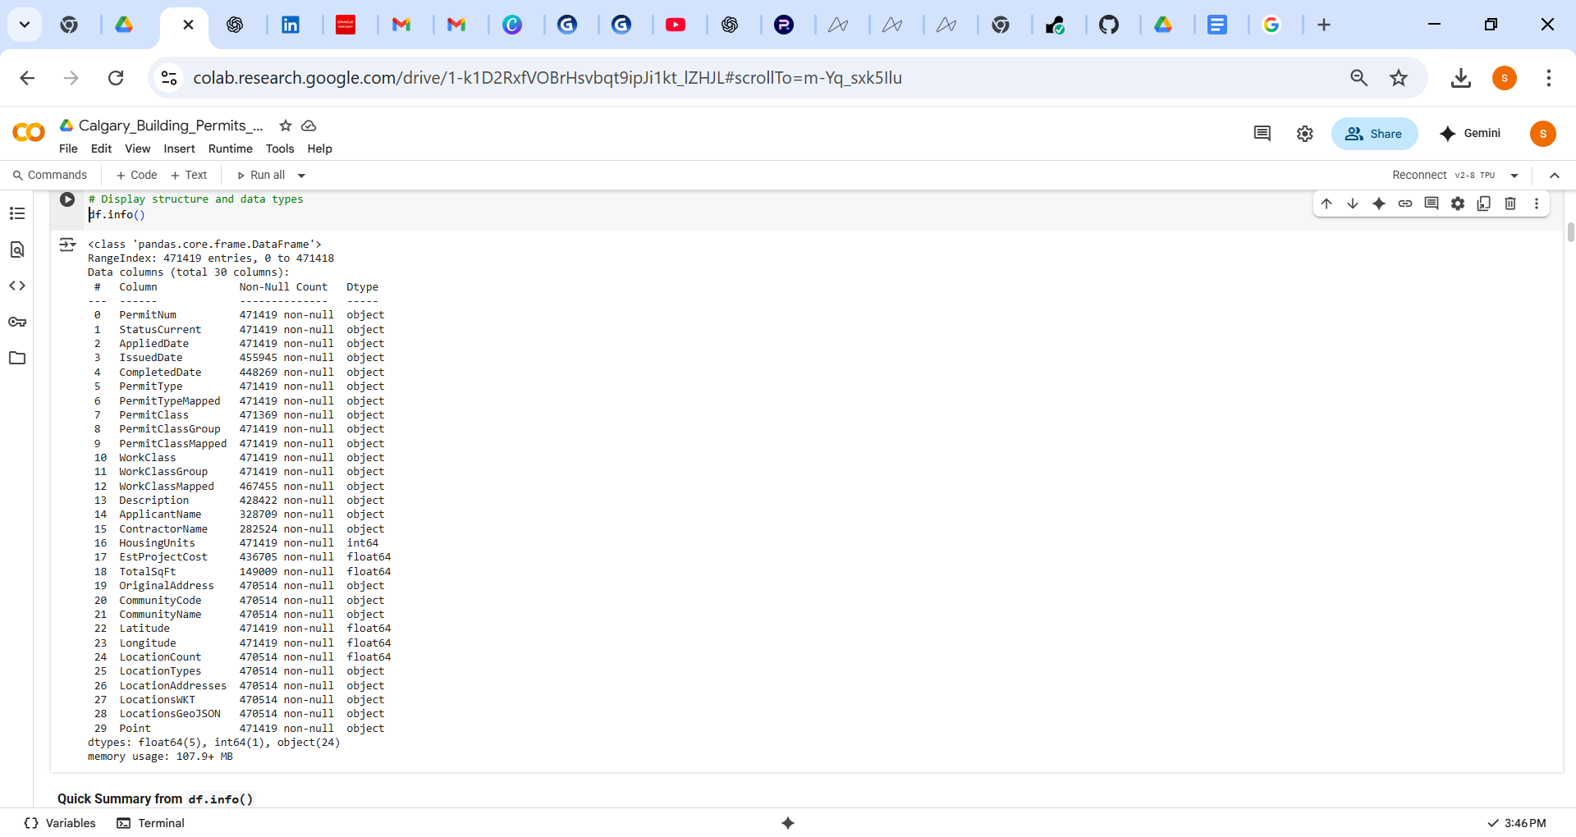
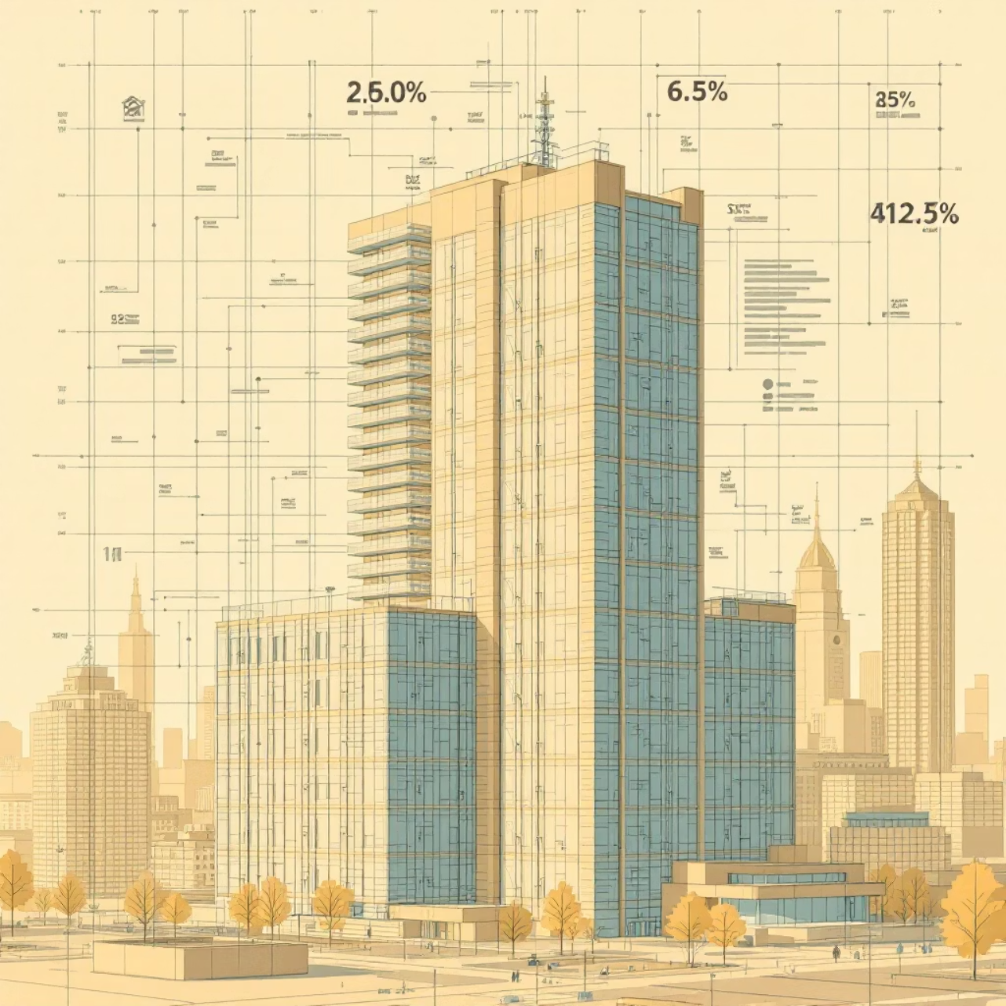
Dataset Overview
The foundation of the analysis is a rich dataset from the City of Calgary Open Data Portal.
Name: City of Calgary Building Permits
Owner: Calgary Open Data
Supplier: City of Calgary, Development Business and Building Services
License: Open Data Terms
Coverage: Since June 22, 1999
Records: 472,000+
Columns: 30 (e.g., PermitType, StatusCurrent, ApplicationDate,
WorkClassGroup, EstProjectCost, CommunityName, TotalSqFt)

Slide 5
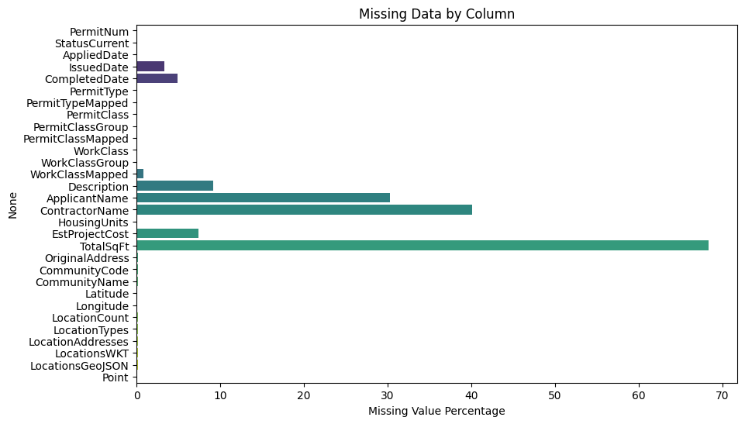
Missing Value Analysis & Data Cleaning
Addressing missing data is crucial for robust model performance.
Key Observations:
High missing values in TotalSqFt (68%), ContractorName (40%), ApplicantName (30%).
EstProjectCost missing in ~7.36% of records – critical since it’s the prediction target.
Remove Records with Missing Target
Action: Dropped rows with missing EstProjectCost
Reason: EstProjectCost is the target variable for prediction
Impact:
Total records: 471,419
Retained: 436,696
Removed: 34,723

Slide 6
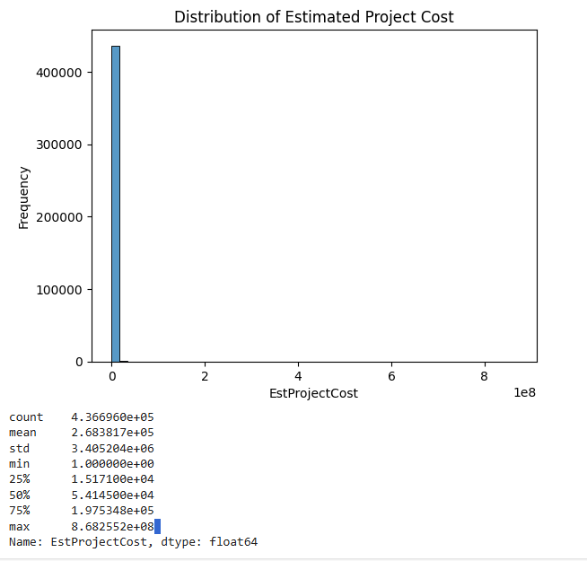
Exploratory Data Analysis (EDA)
Interpretation of Estimated Project Cost Summary
Count: 436,696 projects have cost data available.
Mean: The average estimated project cost is about $268,381.
Std Dev: The large standard deviation (~3.4 million) indicates wide variation in project costs.
Min: Some projects are very cheap or possibly symbolic (minimum cost = $1).
25th Percentile: 25% of projects cost less than ~$15,171.
Median (50th Percentile): Half of the projects cost less than ~$54,145.
75th Percentile: 25% of projects cost more than ~$197,535.
Max: The maximum project cost is extremely high (~$868 million), which may be an outlier or a mega-project.

Slide 7
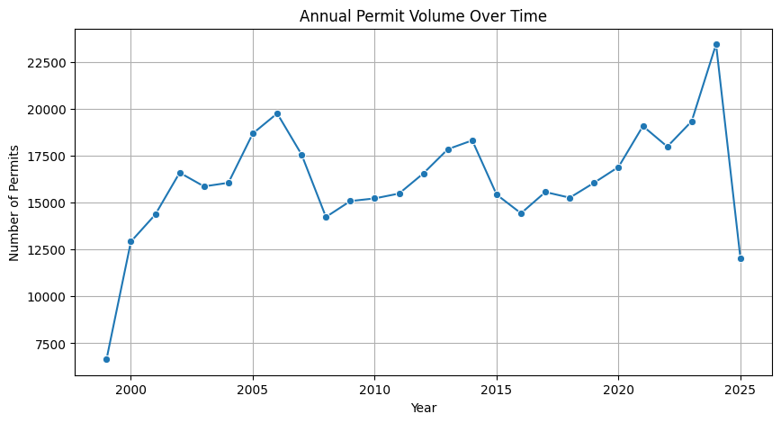
Aggregated Analysis & Key Business Questions
Q1: Permit Volumes Over Time?
Are building permit applications increasing or decreasing annually? Analyzing this trend helps forecast demand for urban services
Extract year from application dates.
Group by year and count permits.
Visualize as a line plot.
Insights: Permit volumes generally show an increasing trend from 1999 to 2024, reflecting growth in construction and development activities.
There are some fluctuations, such as dips around 2008-2010, likely corresponding to economic downturns.
The sharp increase in 2024 could indicate a construction boom or data reporting differences.
Partial data for 2025 shows a lower count, probably due to incomplete reporting year-to-date.
This trend analysis supports urban planning efforts by revealing periods of heightened or reduced building activity over time.

Slide 8
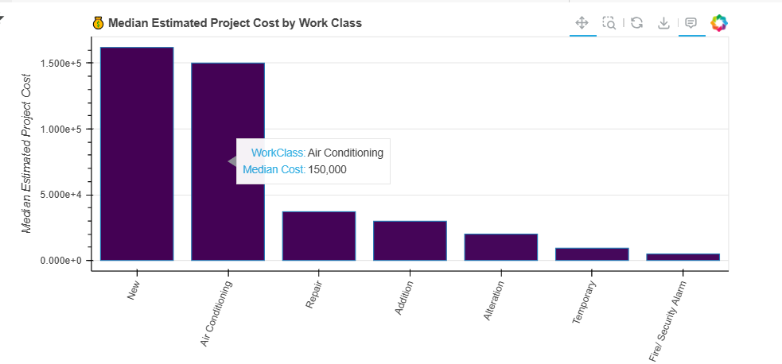
Aggregated Analysis & Key Business Questions
Q2: Which work classes have the highest median estimated project costs in Calgary building permits?
Group by WorkClass and calculate median EstProjectCost.
Sort and plot as an interactive Bokeh bar chart with hover details.
Insights:
High-cost: “New” constructions & HVAC installations exceed $150K median.
Moderate: “Repair,” “Addition,” “Alteration” range ~$20K–$35K.
Low-cost: “Fire/Security Alarm” & “Temporary” under $10K.
These insights help prioritize which permit types are cost-intensive and require closer financial oversight.

Slide 9
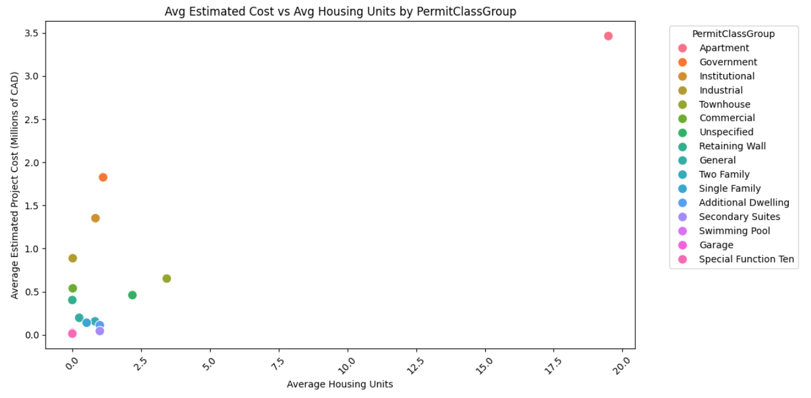
Aggregated Analysis & Key Business Questions
Q3: How does the average estimated project cost relate to the average number of housing units across different permit class groups?
Group data by PermitClassGroup.
Calculate average estimated project cost and average number of housing units.
Visualize with a scatter plot to identify trends or correlations.
Insights:
Apartments and Government projects lead in both cost and housing units, indicating large-scale developments.
Institutional and Industrial have high costs but fewer units.
Townhouses and Two Family homes are moderate in both measures.
Single Family homes dominate in volume but have lower costs and units.
Garages, Pools, and Secondary Suites are low-cost with near-zero units.
Overall, higher housing units generally correspond to higher project costs, with variations by project type.

Slide 10
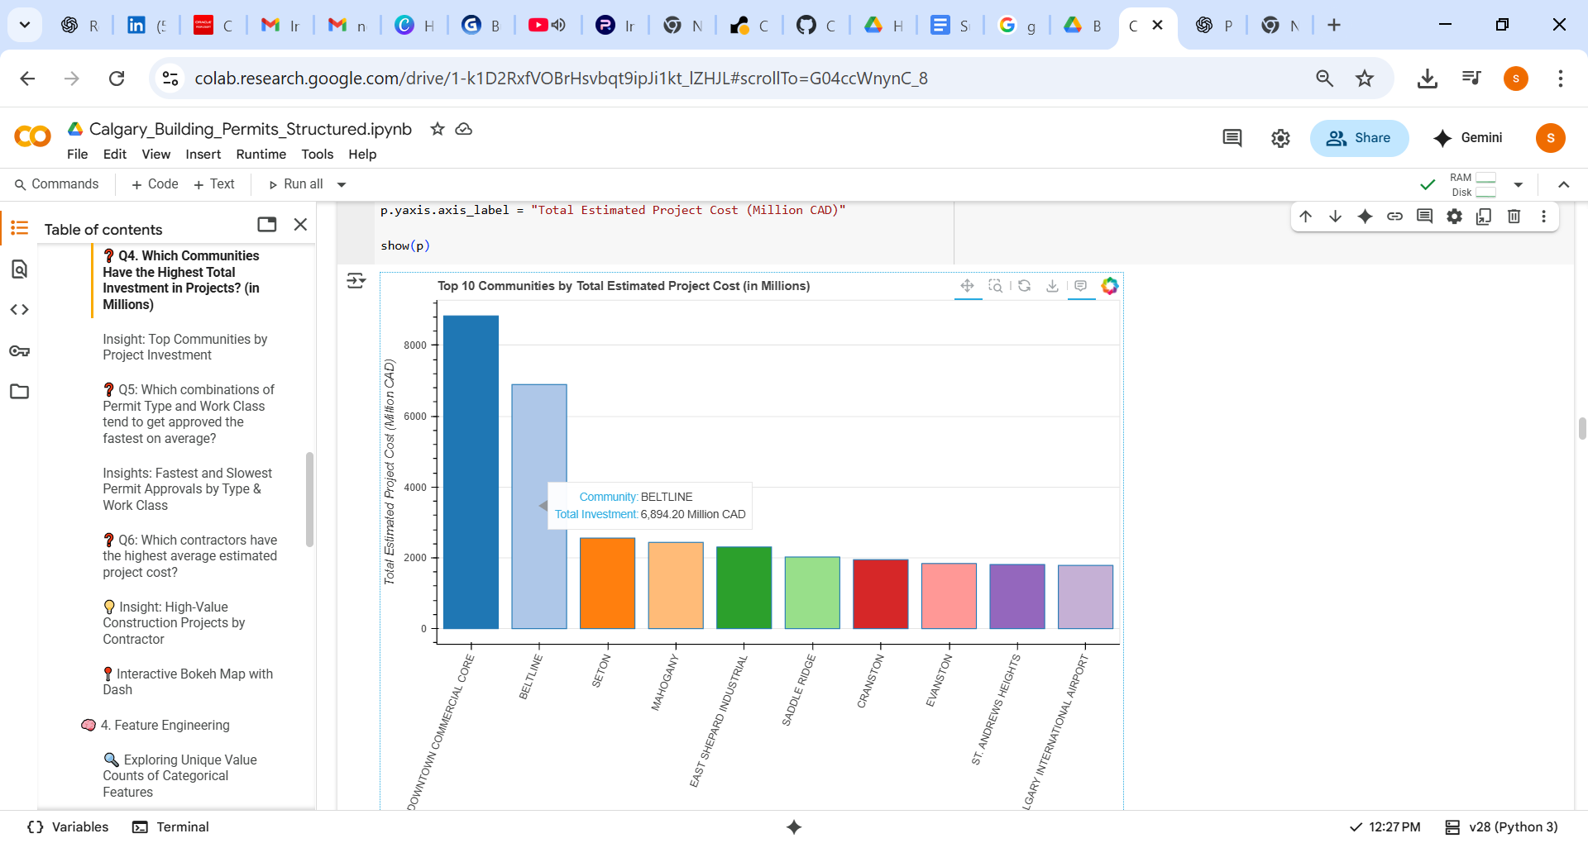
Aggregated Analysis & Key Business Questions
Q4: Which Communities Have the Highest Total Investment in Projects?
Aggregate total estimated project cost by community.
Convert amounts to millions.
Sort and visualize top 10 communities.
Insights:
Downtown Commercial Core leads with a total investment of $8.83 billion, driven by dense commercial and mixed-use projects.
Beltline follows with $6.89 billion, reflecting vibrant urban development.
Seton, Mahogany, and East Shepard Industrial each exceeded $2 billion, showcasing rapid residential and industrial expansion.
Other notable areas include Saddle Ridge, Cranston, Evanston, St. Andrews Heights, and the Calgary International Airport zone, indicating significant suburban, institutional, and infrastructure developments.
📌 This data supports the narrative of balanced urban revitalization and suburban growth in Calgary.

Slide 11
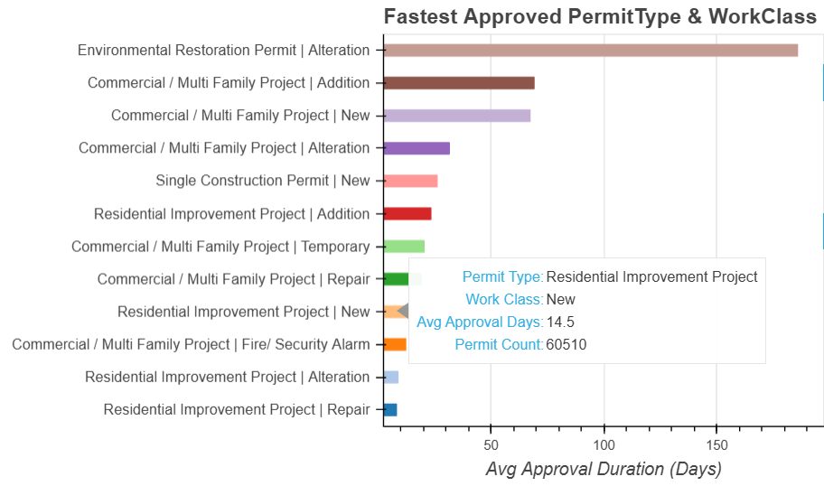
Aggregated Analysis & Key Business Questions
Q5: Which combinations of Permit Type and Work Class tend to get approved the fastest on average?
Group building permits by PermitType and WorkClass.
Calculate the average approval duration and count of permits for each group.
Filter for groups with sufficient volume (more than 100 permits) to ensure statistical significance.
Visualize the top 15 fastest combinations using a horizontal bar chart.
Insights:
Residential permits—especially Repairs and Alterations—receive the fastest approvals, often in under 10 days.
Commercial Additions and Environmental Restoration Alterations experience the longest delays, averaging 60 to 180 days.
High-volume permit types like Residential Alterations and Single Construction - New are typically more streamlined, indicating optimized processes for common applications.

Slide 12
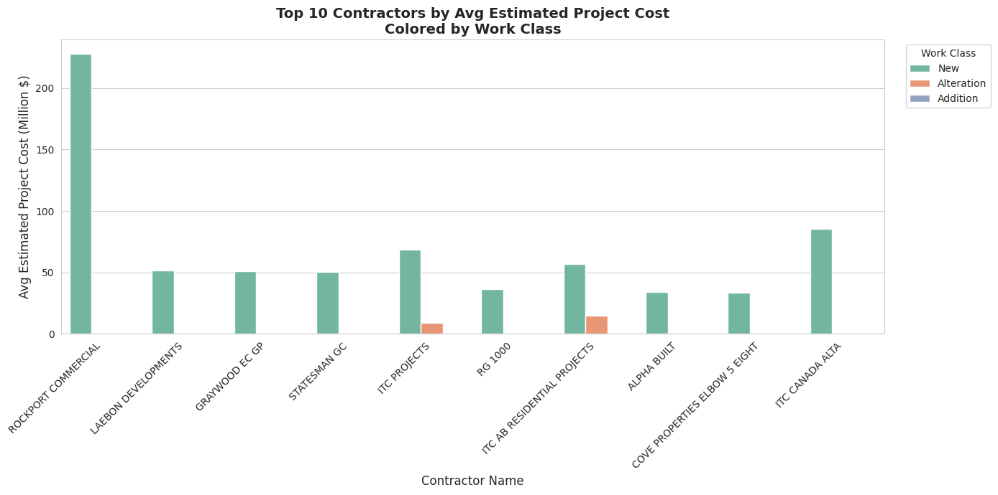
Aggregated Analysis & Key Business Questions
Q6: Which contractors have the highest average estimated project cost?
Group the data by ContractorName and compute the average EstProjectCost.
Select the top 10 contractors with the highest mean estimated project cost.
Visualize the results using a bar chart, applying WorkClass as the hue for deeper insights into project types.
Insights:
Several contractors are engaged in high-value construction projects, with estimated costs exceeding $50 million.
ROCKPORT COMMERCIAL tops the list with a project valued at $228 million.
Other major contributors include:
ITC PROJECTS – up to $68.58 million
ITC CANADA ALTA – up to $85.31 million

Slide 13
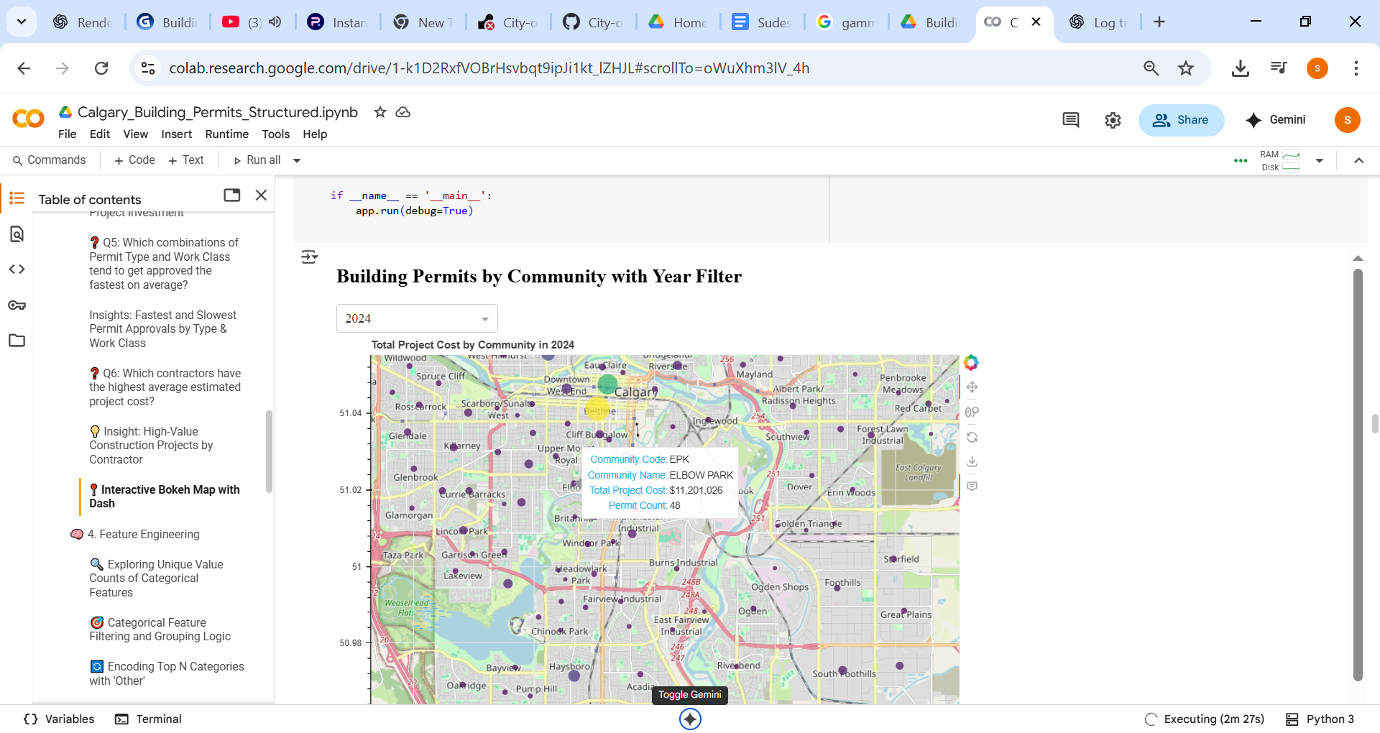
Interactive Bokeh Map with Dash
Developed an interactive dashboard using Dash and Bokeh to visualize the estimated project cost of building permits by community over different years.
A dropdown menu allows dynamic filtering by year.
Bubble sizes represent the magnitude of project costs for each community on a map.
This visualization provides meaningful spatial insights into the intensity and distribution of development activity over time.

Slide 14



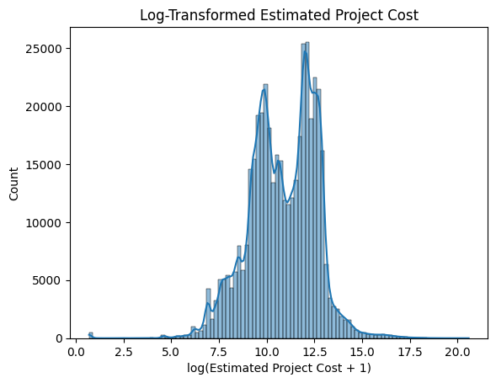
Feature Engineering
Creating new features from existing data to enhance model performance.
Log Transformation
Derived Fields
Categorical Encoding
LogEstProjectCost = log(1 + EstProjectCost)
Natural logarithm transformation of Estimated Project Cost to reduce skewness and handle zero values.
SqFtPerUnit: TotalSqFt / HousingUnits
ApprovalDuration: IssuedDate − AppliedDate
CompletionDuration: CompletedDate − IssuedDate
To reduce dimensionality and focus on the most frequent categories, we group the top 10 categories for selected features and label the rest as "Other":
CommunityName → CommunityName_Top
StatusCurrent → StatusCurrent_Top
ContractorName → ContractorName_Top
PermitClass → PermitClass_Top

Slide 15
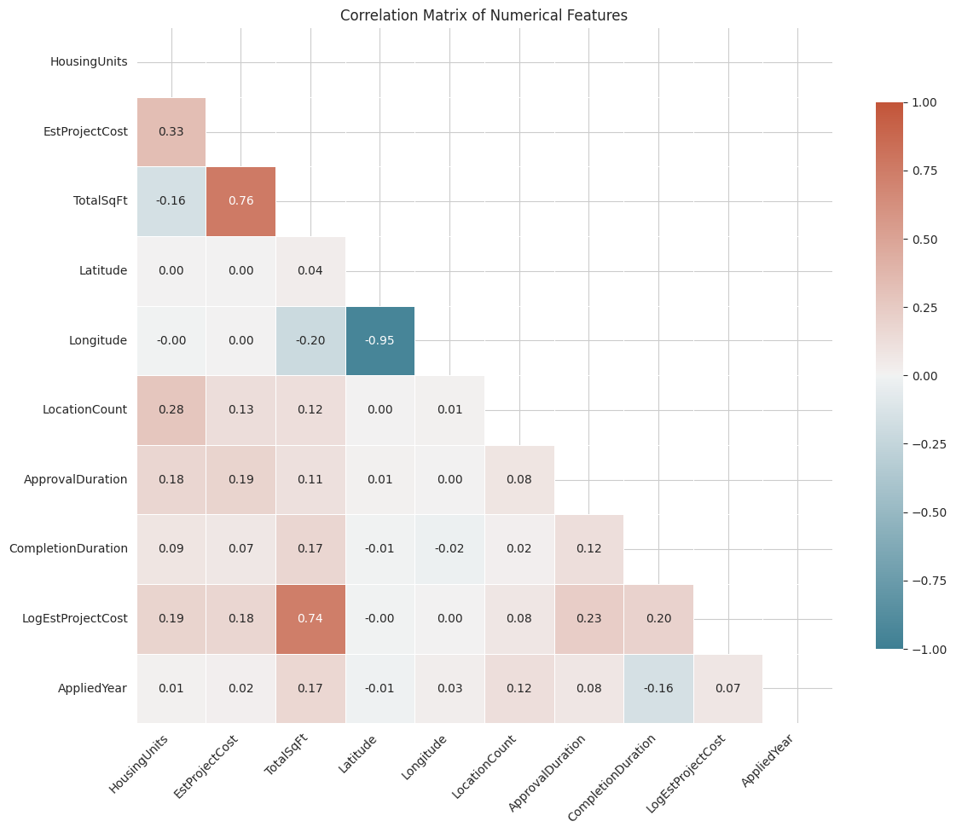
Feature Importance Analysis
Numerical Features Correlation Analysis
TotalSqFt has a high correlation (0.74), indicating size plays a big role.
Moderate importance seen in ApprovalDuration, CompletionDuration, and HousingUnits.
Geographic features like Longitude and Latitude have minimal correlation.

Slide 16
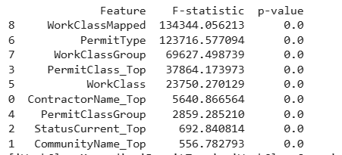
Feature Importance Analysis
Categorical vs. Target Correlation Using ANOVA
Why ANOVA?
Measures if different categories of a feature have significantly different mean values of the continuous target (LogEstProjectCost).
Helps identify informative categorical features before encoding and modeling.
Low p-value indicates a strong relationship between the categorical feature and the target.
Prioritize top features with lowest p-values and highest F-statistics for feature engineering and model building.
All tested categorical features significantly influence the estimated project cost, with WorkClassMapped, PermitType, and WorkClassGroup showing the strongest effects based on high F-statistics and near-zero p-values.

Slide 17

Missing Value Handling
Addressing missing data is crucial for robust model performance.
Numerical Imputation
Created a group key by combining PermitClassGroup and CompletionDuration to capture project-specific context and used the group median to impute missing TotalSqFt values.
Additionally, applied a HistGradientBoostingRegressor model to predict the remaining missing TotalSqFt values for improved accuracy.
Categorical Imputation
WorkClassMapped had 3,257 missing values and was imputed using WorkClassGroup to maintain categorical consistency.
Date Gap Filling
For records with missing ApprovalDuration and CompletionDuration, fill using the median value grouped by 'PermitClassGroup' and 'WorkClassGroup' to preserve contextual accuracy.

Slide 18




Outlier Removal & Impact
Noise Reduction
Extreme values were either removed or capped to mitigate noise and improve data quality.
Stable Model Training
Resulted in significantly more stable and reliable model training, enhancing prediction accuracy.
Preserved High-Value Data
Valid large projects were kept separate for specialized, high-value analysis, ensuring no critical data was lost.

Slide 19
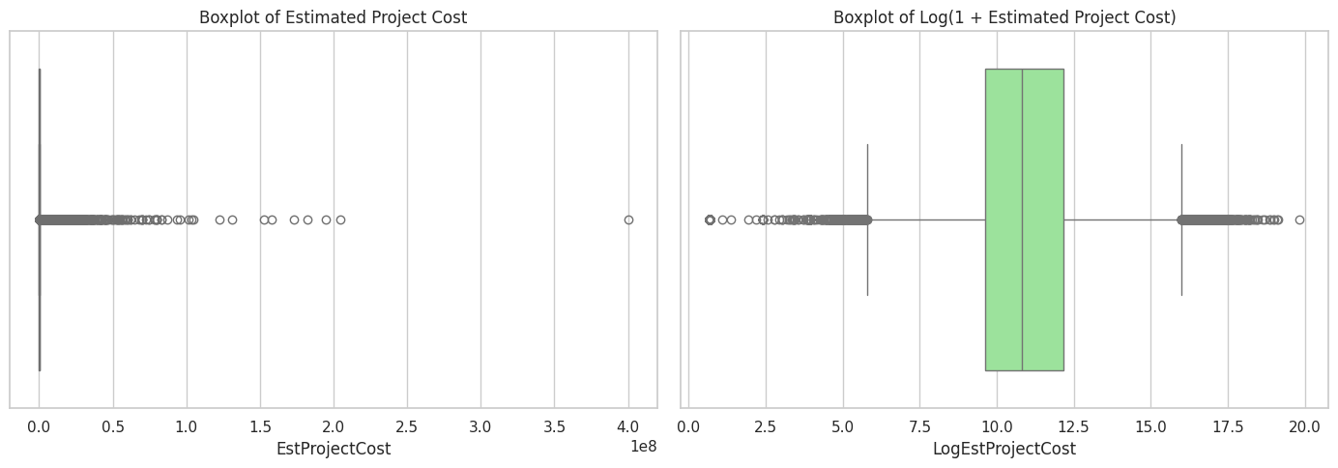
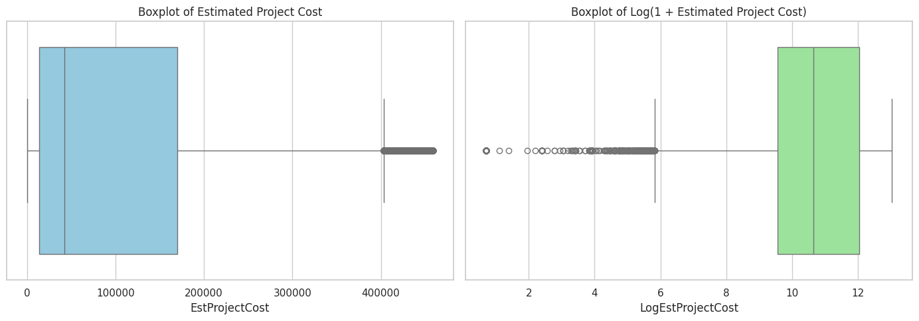
Outlier Filtering & Data Cleaning
Duration Filters:
ApprovalDuration 0–365 days
CompletionDuration 0–1000 days
Cost Filter:
IQR method for EstProjectCost outliers
Housing Units Filter:
Keep HousingUnits ≥ 0
Validation:
Checked valid entries for each filter separately and combined
Final Dataset: 378,303 records ready for modeling
Purpose:
Remove outliers/incorrect entries to improve model reliability

Slide 20
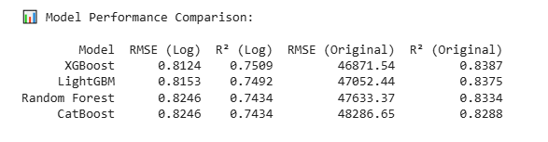
Model Training, Prediction, and Evaluation
Modeling Approach:
Applied four regression models on the filtered dataset to predict the logarithm of the estimated project cost (LogEstProjectCost):
Random Forest Regressor
XGBoost Regressor
LightGBM Regressor
CatBoost Regressor
This approach enables a fair performance comparison across advanced gradient boosting and ensemble methods.
Objective: Identify the most effective model for accurate project cost estimation.
XGBoost delivered the best overall performance on both log-transformed and original scales.
LightGBM was a close second with minimal drop in accuracy.
Random Forest and CatBoost showed comparable but slightly lower performance.
Performance differences are small, indicating all four are viable, but XGBoost is optimal for this dataset.

Slide 21
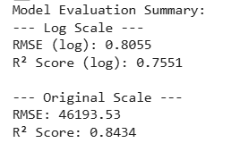
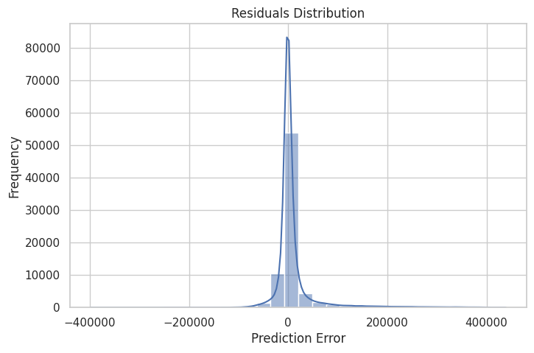
Model Training, Prediction, and Evaluation
XGBoost Model – Test Results
Train/Test Split: 80/20 (random_state=42)
Preprocessing:
ColumnTransformer → scale numericals with StandardScaler, encode categoricals with OneHotEncoder.
Model: XGBoost Regressor (tuned hyperparameters)

Slide 22
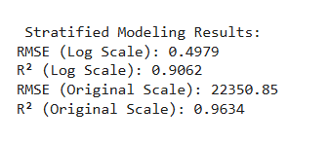
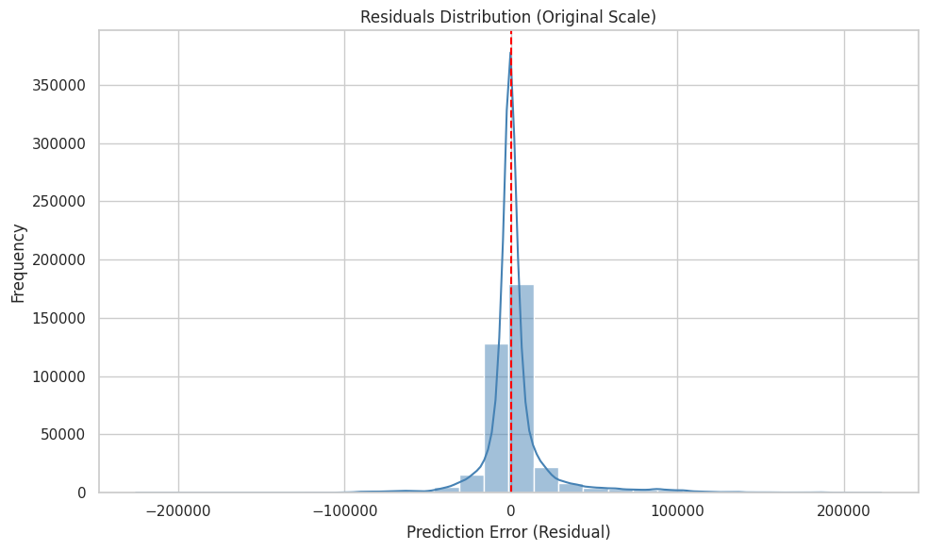
Model Training, Prediction, and Evaluation
Stratified Modeling for Project Cost Estimation
Objective
Improve prediction accuracy by segmenting projects into Small, Medium, and Large cost groups
and training dedicated models for each.
Stratification Criteria
Group | Cost Range
Small | Cost < $14,000
Medium | $14,000 ≤ Cost ≤ $170,000
Large | Cost > $170,000
Why Stratified Modeling?
Different cost ranges show distinct patterns and feature impacts.
Helps avoid a one-size-fits-all model which may be skewed by large-cost outliers.
Significantly improves prediction accuracy when grouping is accurate.
Challenge: Generalization on New (Unknown) Data
During inference, project grouping must be predicted first by predicting the
cost from XGBRegressor
If group prediction is incorrect → cost estimation from the wrong model → high error.
Takeaway
Stratified models improve performance within known categories,
but their success heavily depends on accurate initial grouping.
Robust group classification is critical for deployment!

Slide 23
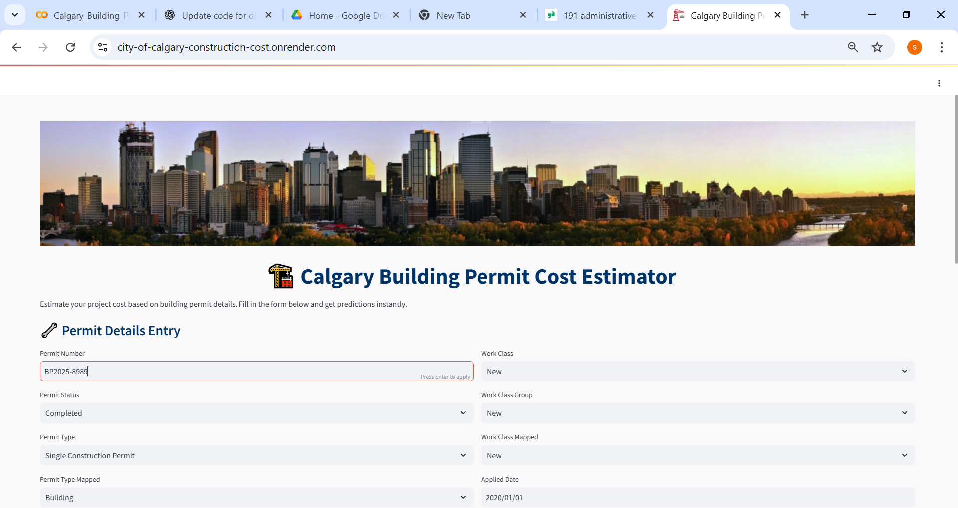
Streamlit Application
Link to access:
https://city-of-calgary-construction-cost.onrender.com/

Slide 24
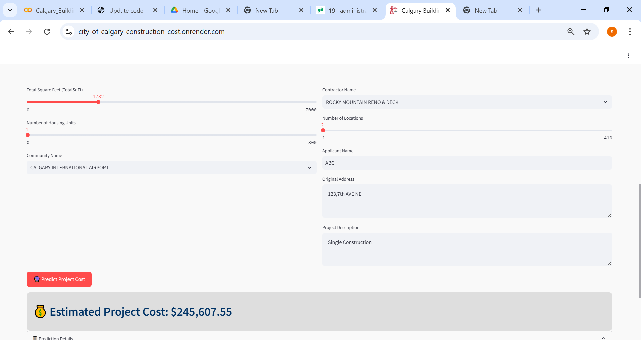
Streamlit Application
Link to access:
https://city-of-calgary-construction-cost.onrender.com/

Slide 25
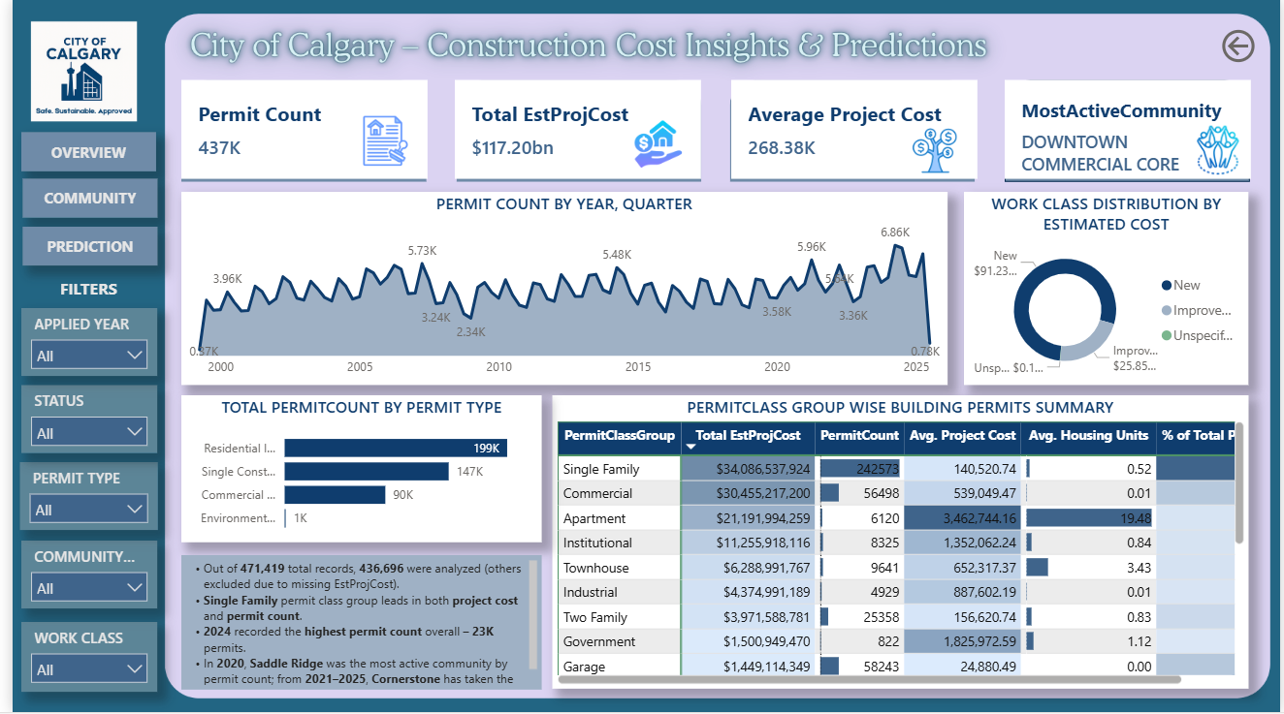
PowerBI Visualization
Overview Page
Link to access: https://mavenshowcase.com/project/41217

Slide 26
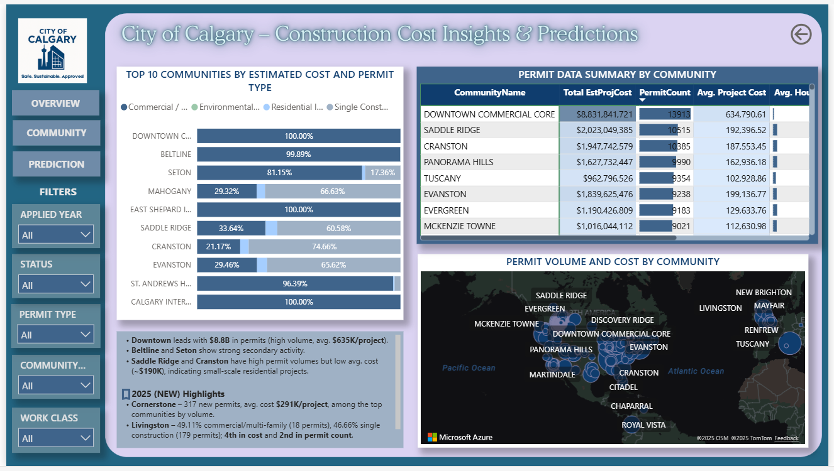
PowerBI Visualization
Community Insight Page
Link to access: https://mavenshowcase.com/project/41217

Slide 27
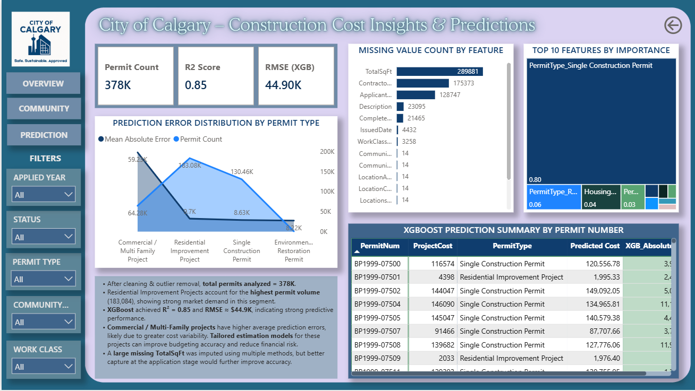
PowerBI Visualization
Prediction Insight Page
Link to access: https://mavenshowcase.com/project/41217

Slide 28
Conclusion & Future Work
Key Takeaways:
This project provides an end-to-end data-driven solution to analyze, predict, and visualize Calgary’s
construction trends.
It helps planners, developers, and city officials budget and prioritize based on real insights.
The tools developed are scalable and can be extended to other cities or permit types.
Next Steps:
Incorporate real-time data feeds for ongoing prediction updates
Explore deep learning for more complex pattern recognition

Slide 29
Thank You

